Slide 1
UCART20X22: ALLOGENEIC DUAL CAR T-CELLS FOR THE TREATMENT OF B-CELL MALIGNANCIES
Roman Galetto, PhD
Preclinical Vice President
June 2nd 2023

Slide 2
Forward-Looking Statements
This presentation contains “forward-looking” statements within the meaning of applicable securities laws, including the Private Securities Litigation Reform Act of 1995. Forward-looking statements may be identified by words such as “designed to”, “anticipate,” “expected,” “on track,” “plan,” “scheduled,” "should", and “will,” or the negative of these and similar expressions.
These forward-looking statements, which are based on our management’s current expectations and assumptions and on information currently available to management, including information provided or otherwise publicly reported by our licensed partners. Forward-looking statements about advancement, timing and progress of clinical trials (including with respect to patient enrollment and follow-up), the timing of our presentation of data and submission of regulatory filings, the adequacy of our supply of clinical vials, the operational capabilities at our manufacturing facilities, and the sufficiency of cash to fund operations.
These forward-looking statements are made in light of information currently available to us and are subject to numerous risks and uncertainties, including with respect to the numerous risks associated with biopharmaceutical product candidate development.
With respect to our cash runway, our operating plans, including product development plans, may change as a result of various factors, including factors currently unknown to us. Furthermore, many other important factors, including those described in our Annual Report on Form 20-F and the financial report (including the management report) for the year ended December 31, 2022 and subsequent filings Cellectis makes with the Securities Exchange Commission from time to time, as well as other known and unknown risks and uncertainties may adversely affect such forward-looking statements and cause our actual results, performance or achievements to be materially different from those expressed or implied by the forward-looking statements. Except as required by law, we assume no obligation to update these forward-looking statements publicly, or to update the reasons why actual results could differ materially from those anticipated in the forward-looking statements, even if new information becomes available in the future.

Slide 3
UCART20x22: Overcoming CAR T Challenges with Next Generation Dual Antigen Target
CAR20
Targeting CD20
TALEN® Powered*
TRAC KO
Minimizes risk of GvHD
For B-cell malignancies
CAR22
Targeting CD22
CD52 KO
Resistance to alemtuzumab
Lentiviral vector
* TALEN® edited UCART cells have been in clinical use since 2015, with ~220 patients dosed
CD52
First allogeneic dual CAR T cell product candidate:
Dual targeting designed for better killing & to prevent escape
Strong alternative to CD19 (highly competitive/crowded/CD19 negative relapses)
CD22 and CD20 are validated targets in B-cell malignancies

Slide 4
UCART20x22 is an “Off-The-Shelf” product candidate
Scalable Manufacturing
Robustness
Market Access
Reduced cost
Scalable manufacturing: 1 batch = 100s doses
The goal is to provide potency and consistency to each patient
Immediately available to all eligible patients

Slide 5
CAR20x22 cells are active against tumor cells with different antigen expression
CD20⁺CD22⁺
Target cells
Cytotoxicity Assay
ELISA IFNγ
CAR20x22
CAR22
CAR20x22
CAR22
CD20⁻CD22⁺
Target cells
CD20⁺CD22⁻
Target cells
No TD
CD20⁻CD22⁺
CD20⁻CD22⁻
CD20⁺CD22⁺
CD20⁺CD22⁻
Target cells
CAR20x22
CAR22
CAR20x22
CAR22

Slide 6
Robust and Sustained Multiple Antigen Targeting in vitro
Time
CD20⁺CD22⁺
Target cells
CD20⁻CD22⁺
Target cells
CD20⁺CD22⁻
Target cells
UCART20x22 exhibits robust and sustained cytolytic activity in vitro

Slide 7
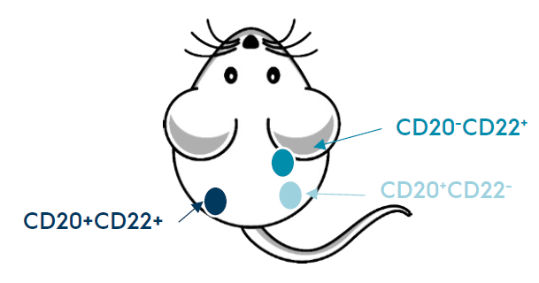
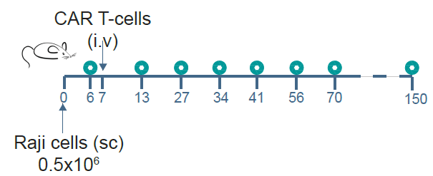
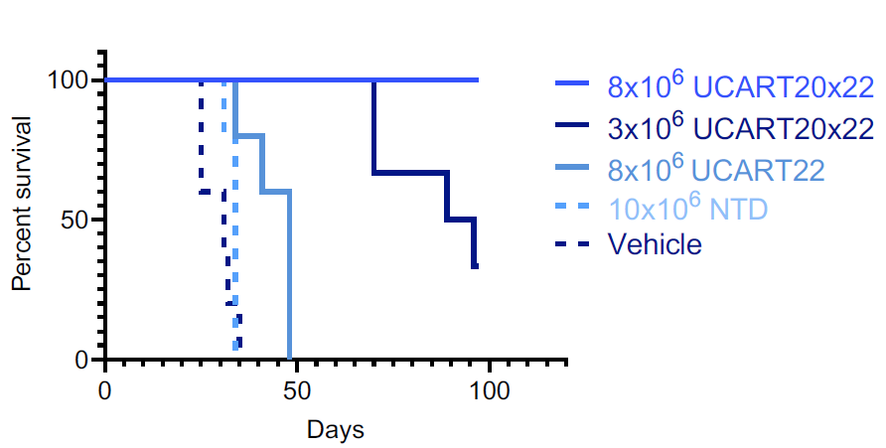
Multiple Antigen Targeting with a dual CAR in vivo
Different tumor antigen
combinations in one mouse
(Raji cell lines)
CD20⁻CD22⁺
CD20⁺CD22⁻
CD20⁺CD22⁺
UCART20x22 efficiently eradicates tumors with different CD20/CD22 antigen combinations in a dose dependent manner

Slide 8
Large Scale Manufacturing of UCART20x22 using TALEN® technology
Frozen
Leukopack
Avoids manufacturing delay/failure at reduced costs
Lentivector
transduction
rLV
TALEN®-mediated
gene editing
mRNA
Use of mature T-cells from healthy donors
Product manufactured and QCed in advance
Consistent manufacturing
Ability to treat multiple patients with a single batch
Cell expansion
Purification
Fill & Finish

Slide 9
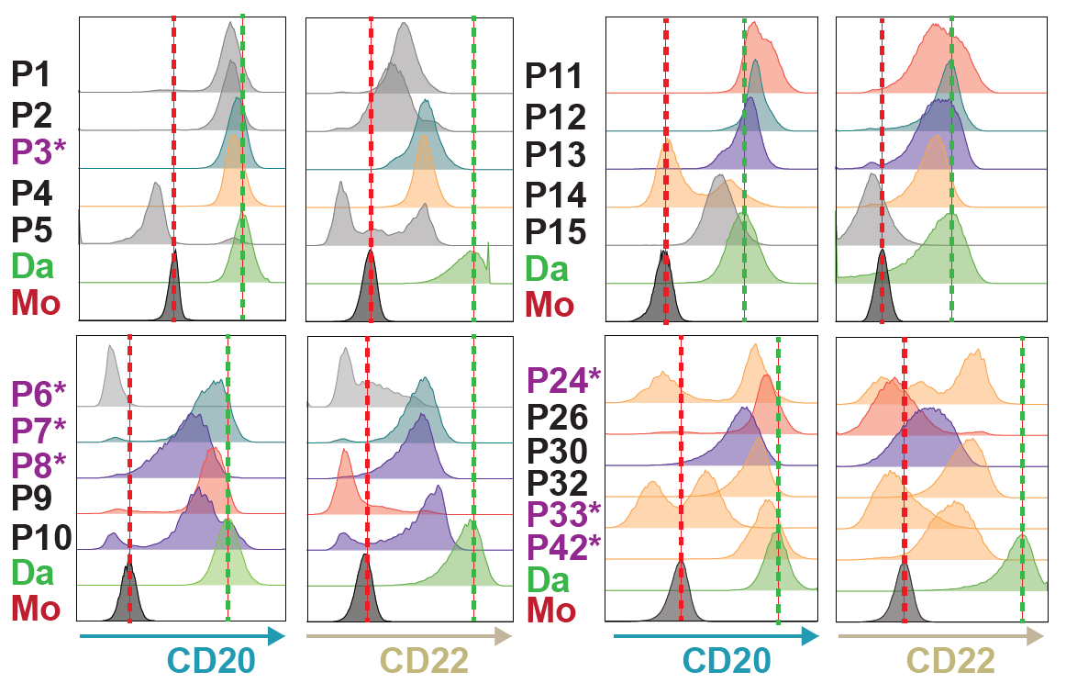
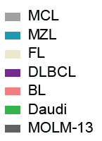
Efficient B-NHL Primary Sample Targeting with UCART20x22 in vitro
Primary B-NHL tumors expressing CD20 and CD22
Cytotoxic activity against B-NHL primary samples
E/T ratio
* Samples from patients previously treated with rituximab
UCART20x22 efficiently targets primary samples of B-NHL cells

Slide 10
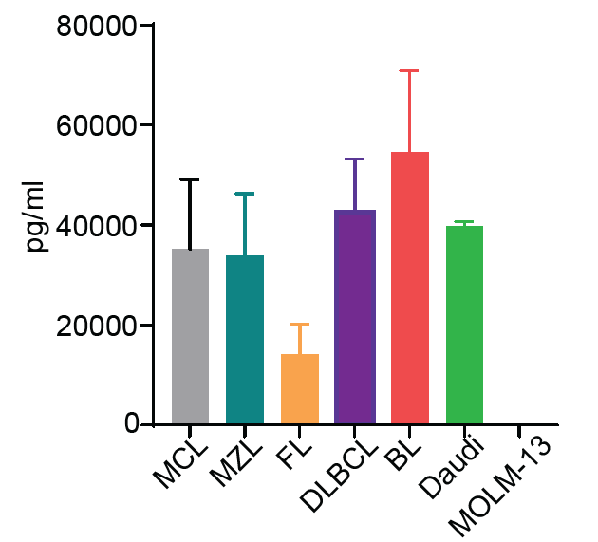
Efficient B-NHL Primary Sample Targeting with UCART20x22 in vitro
Primary B-NHL tumors expressing CD20 and CD22
IFNγ release against B-NHL primary samples
* Samples from patients previously treated with rituximab
UCART20x22 efficiently targets primary samples of B-NHL cells

Slide 11
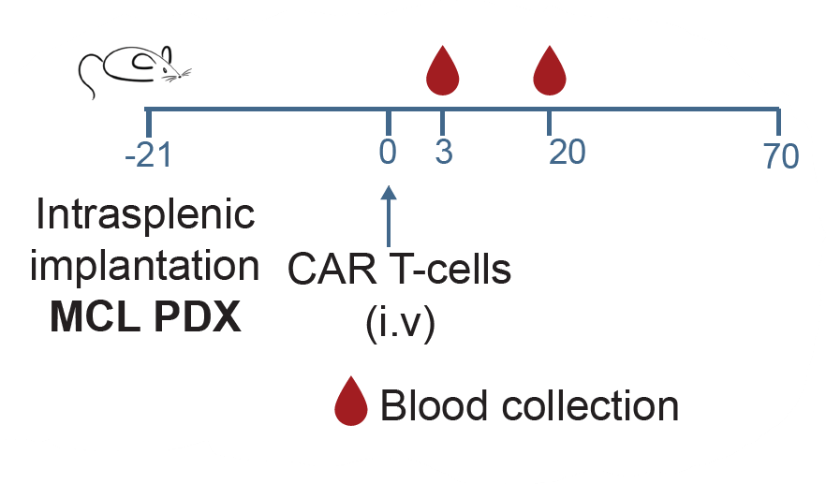
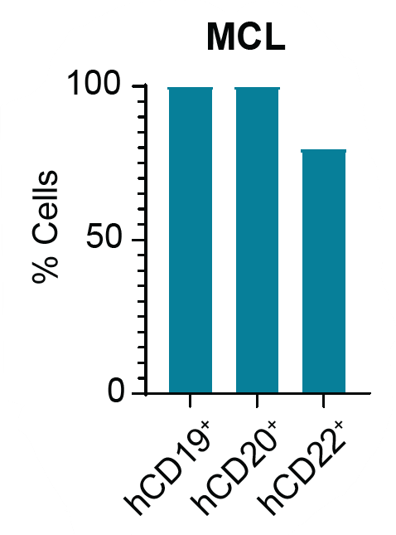
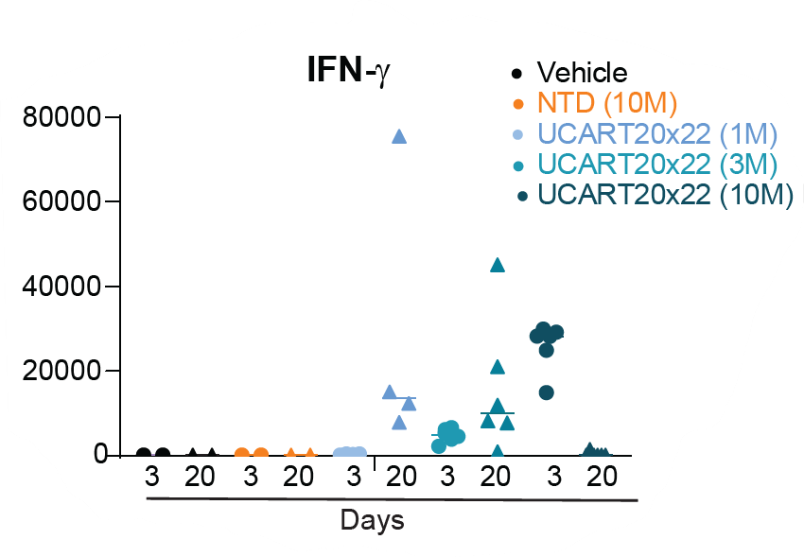
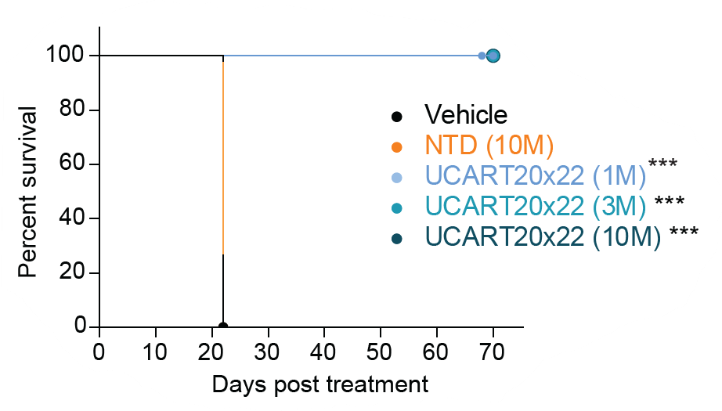
UCART20x22 antitumor activity in a B-NHL PDX in vivo model
IFNγ release (pg/ml)

Slide 12
In vivo antitumor activity of a GMP representative batch of UCART20x22
Daudi-Luc tumor model
GMP representative batch
Treatment groups:
vehicle
UCART20x22
1x10⁶ cells/mice
3x10⁶ cells/mice
10x10⁶ cells/mice
UCART20x22 extends survival in a dose dependent manner

Slide 13
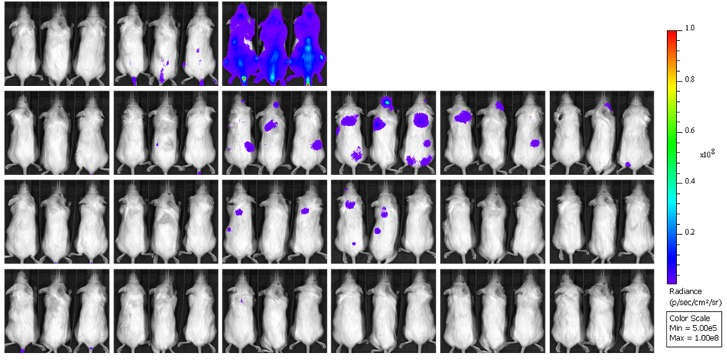
In vivo antitumor activity of a GMP representative batch of UCART20x22
Daudi-Luc tumor model
GMP representative batch
Treatment groups:
vehicle
UCART20x22
1x10⁶ cells/mice
3x10⁶ cells/mice
10x10⁶ cells/mice
Vehicle
1M
3M
UCART20x22
10M
D -1
D 7
D 14
D 21
D 28
D 35
UCART20x22 controls tumor progression in a dose dependent manner

Slide 14
CONCLUSIONS
CONCLUSIONS
UCART20x22 is an allogeneic CART T-cell product engineered through TALEN® mediated editing of TRAC and CD52 genes, to prevent Graft-vs-Host Disease and to provide resistance to alemtuzumab
Pre-clinical proof of concept demonstrates activity of UCART20x22 dual CAR T-cells for the treatment of B-cell malignancies:
Robust in vitro cytolytic activity against tumors expressing different antigen combinations or diverse CD20 and CD22 expression levels
Efficient and dose dependent tumor control in different in vivo models
Allogeneic UCART20x22 cells have the potential to
Overcome common mechanisms of resistance in B-NHL,
Grant access to an allogeneic “off-the-shelf” CAR T-cell option for B-NHL patients,
Reduce the time from treatment decision to infusion.
The ongoing Phase-I FIH Clinical Trial NatHaLi-01, evaluating UCART20x22 safety and activity in patients with R/R B-NHL is currently open in US, France and Spain

Slide 15
UCART20x22 – NATHALI-01 Trial Design
Open-Label Dose-Finding and Dose-Expansion Study to Evaluate the Safety, Expansion, Persistence, and Clinical Activity of UCART20x22 In Subjects with Relapsed or Refractory B-Cell Non-Hodgkin’s Lymphoma (B-NHL)
Dose Escalation
LD regimen: FCA
Determine MTD and/or RP2D
Dose Expansion
LD regimen: FCA
Objectives
Key Eligibility Criteria
Dose Levels
Primary
Safety and tolerability
MTD/RP2D
Secondary
Investigator assessed overall response rate (ORR)
Duration of response
Progression-free survival (PFS)
Overall survival (OS)
Patients aged 18 years to 80 years
ECOG PS ≤1
Relapsed or refractory (R/R) mature B-NHL per 2016 WHO criteria and positive for CD20 and/or CD22
R/R disease after at least 2 lines of prior treatment
FCA1: F: 30 mg/m²/d x 3d; C: 500 mg/m²/d x 3d; A: 12 mg x1d, 24 mg x2d
Dose Level(s) | Subjects ≥50 kg | Subjects ≤50 kg
DL-1 | 20 x 10⁶ | 14 x 10⁶
DL1 | 50 x 10⁶ | 35 x 10⁶
DL2 | 150 x 10⁶ | 105 x 10⁶
DL3 | 450 x 10⁶ | 315 x 10⁶
NCT05607420
MTD: Maximum Tolerated Dose; RP2D: Recommended Phase 2 Dose; LD: Lymphodepletion; FCA: Fludarabine + Cyclophosphamide + Alemtuzumab; WHO: World Health Organization; ECOG PS: : Eastern Cooperative Oncology Group Performance Status; DL: Dose Level; NHL: Non-Hodgkin Lymphoma

Slide 16
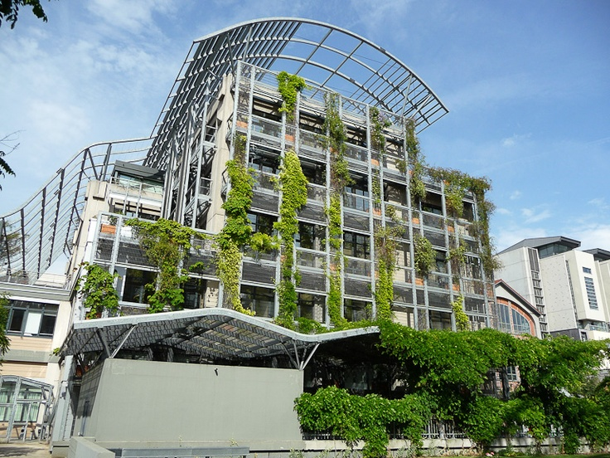
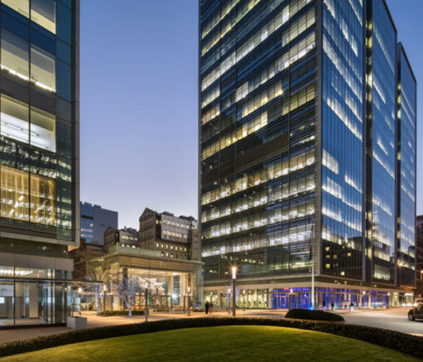
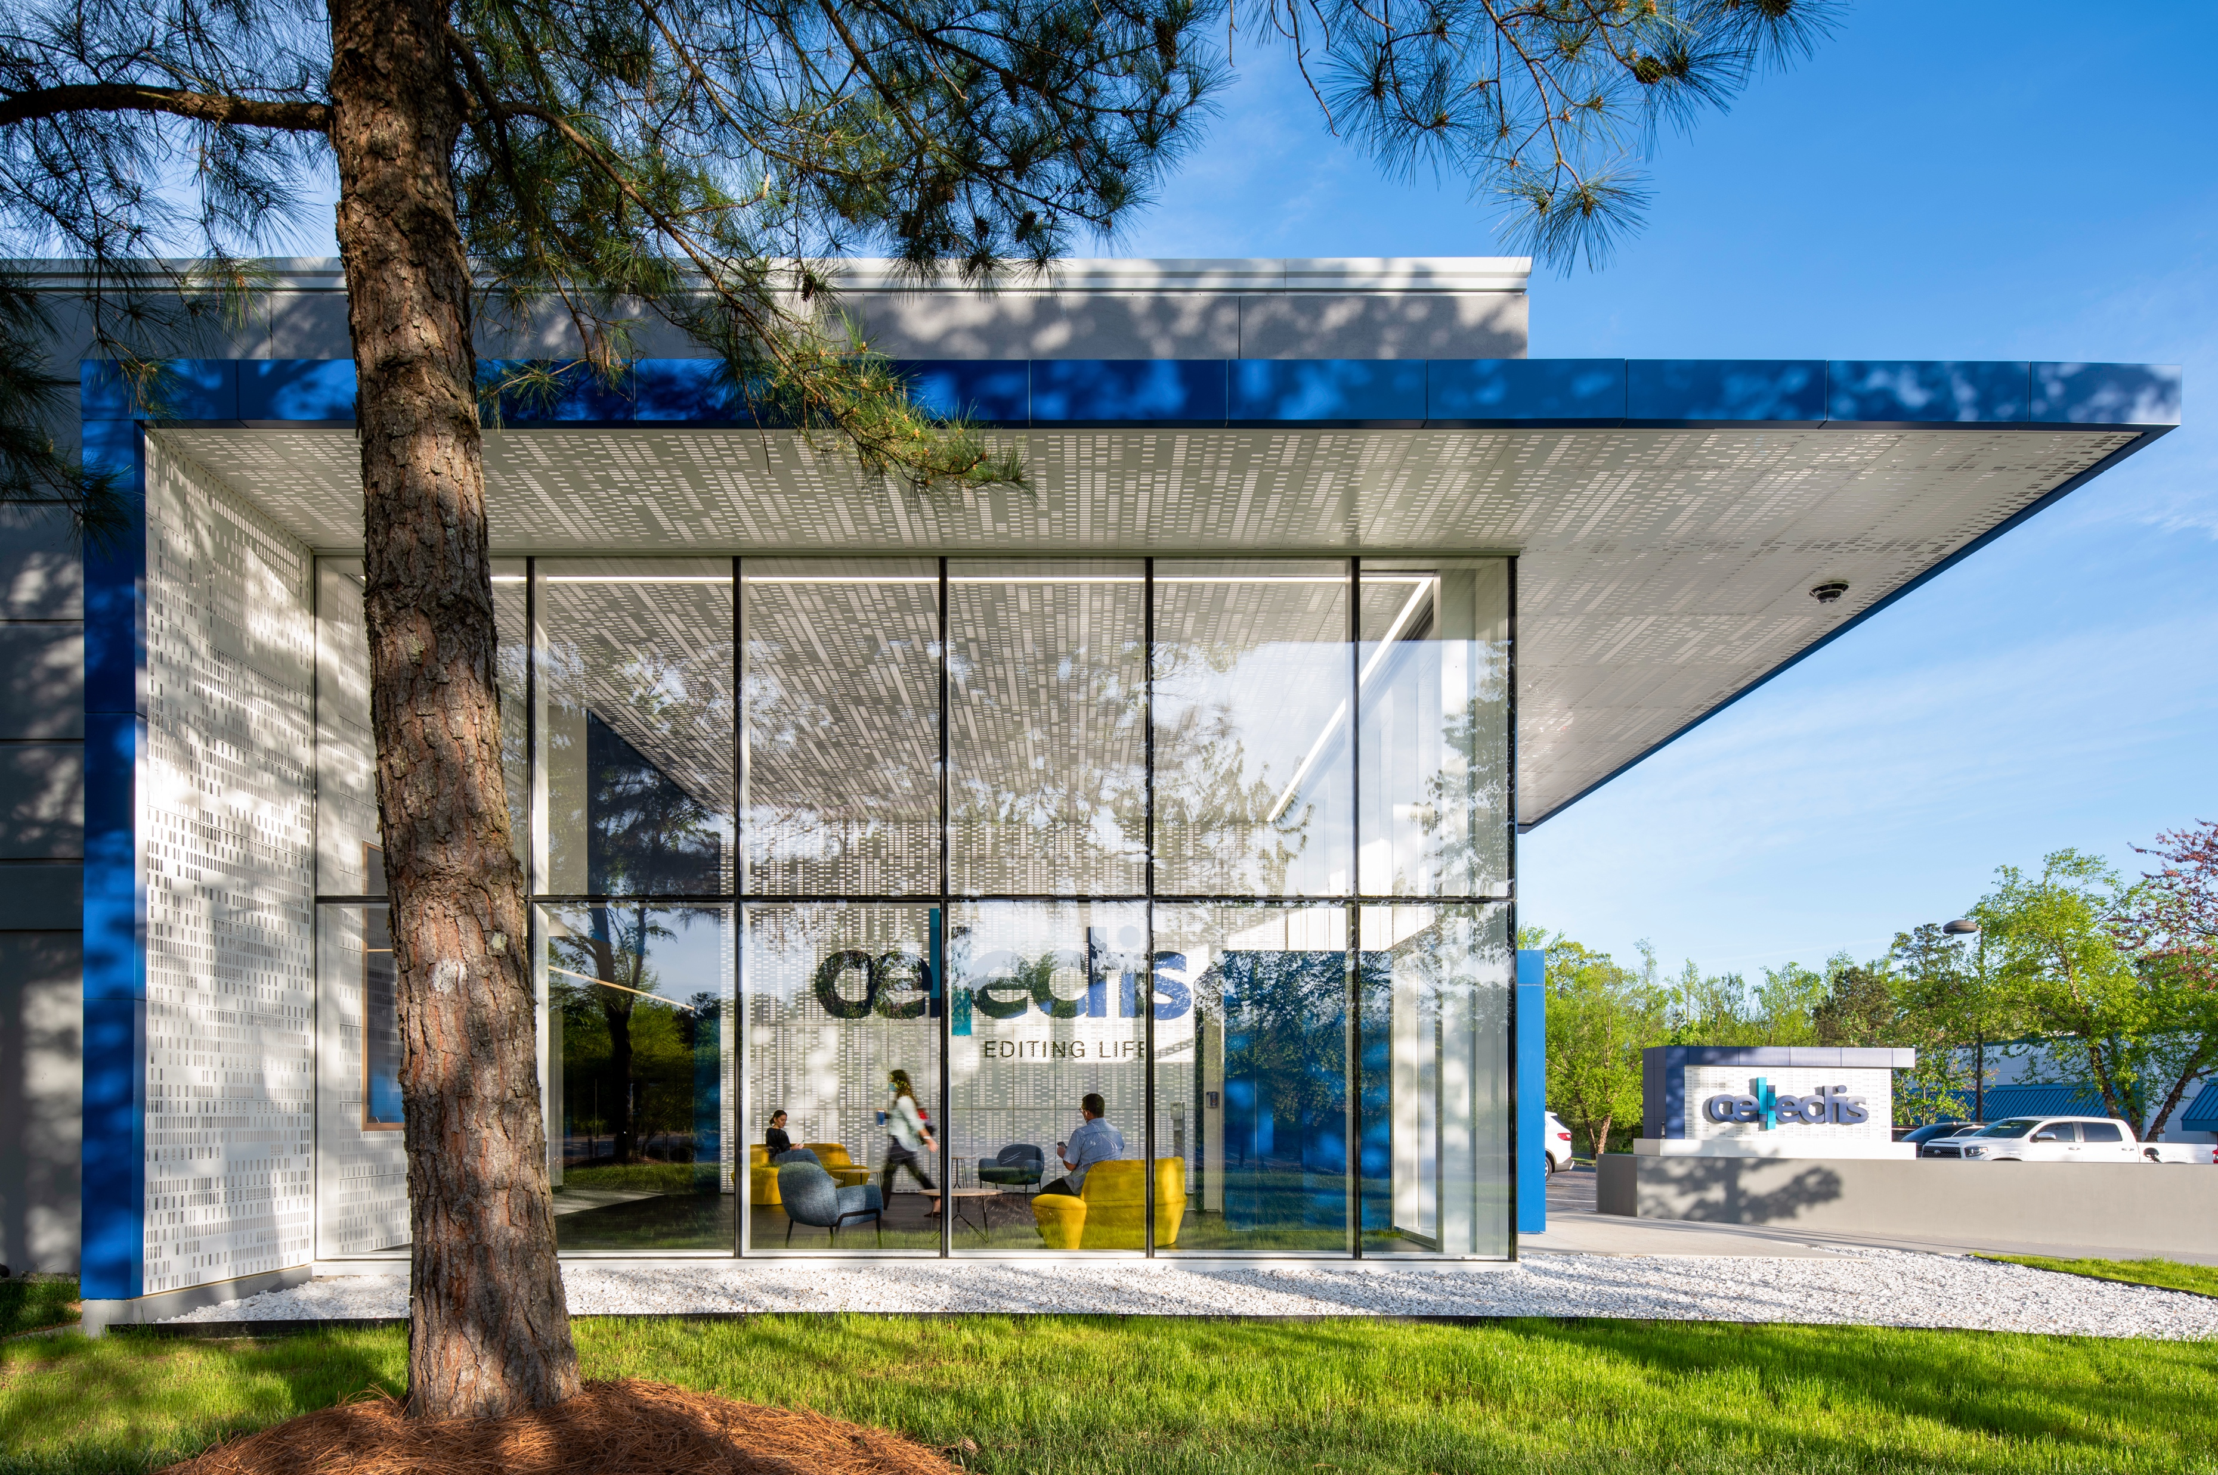
Thank You
Reach us at:
investors@cellectis.com
Cellectis Paris
8, rue de la Croix Jarry 75013 Paris – France
Cellectis New York
430 East 29th Street
New York, NY, 10016 – USA
Cellectis Raleigh
2500 Sumner Boulevard
Raleigh, NC, 27616 – USA

